Slide 1

EBA3500 Lecture 4 Inference, transformations, correlation
Jonas Moss

Slide 2

Inference: Regression from a statistician's viewpoint

Slide 3
Where does the data come from?
Data generating process
Data generating model

Slide 4
Data generating process – think simulation!
import numpy as np
rng = np.random.default_rng(seed = 313)
# One model
x = np.linspace(0, 1, num = 100)
y = np.exp(3 * x ** 2) + rng.uniform(-1, 1, 100)
# Another model
x = np.linspace(0, 1, num = 100)
y = 3 + 2 * x + rng.uniform(-1, 1, 100)

Slide 5

The case of Alice and Bob

Slide 6

Alice Generates Some data using her data generating model

Slide 7

Bob Doesn’t know the data generation process. He must guess a model for the data!

Slide 8
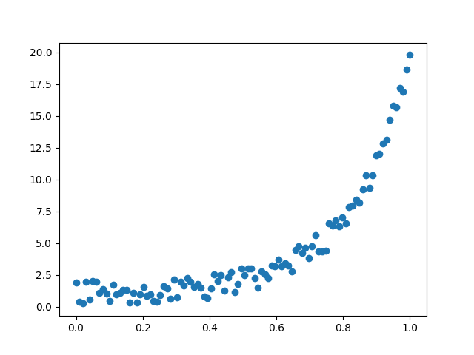
Alice generates some non-linear data

Slide 9
But Credulous Bob doesn’t care – he believes in the linear model!

Slide 10
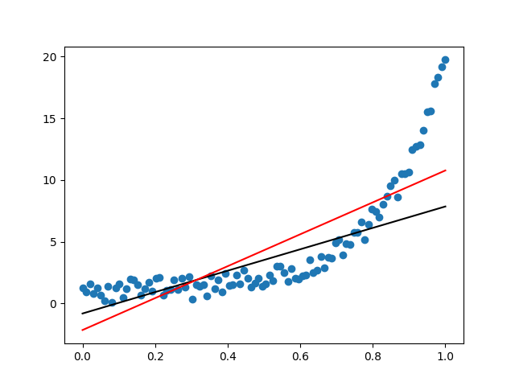
That’s why he ends up with this thing!

Slide 11

Foundation of statistics: Be like credulous Bob! Just believe that the model is true!

Slide 12
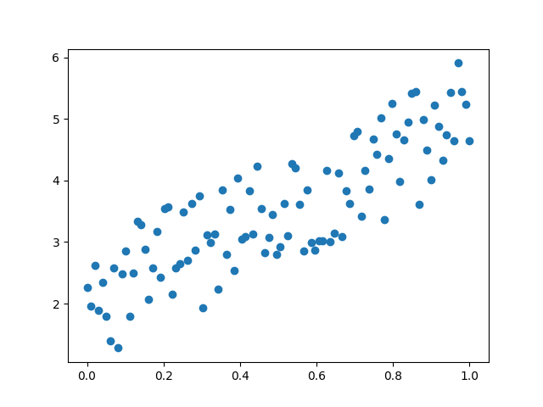
That «thing» on the left can’t possibly happen!!!

Slide 13
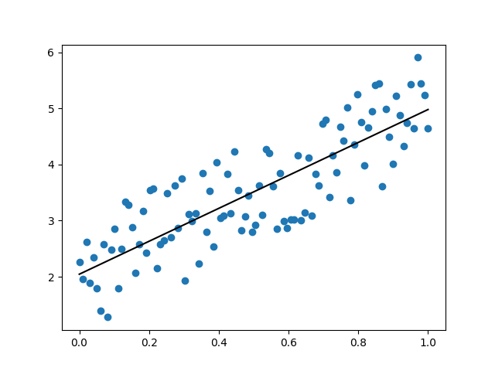
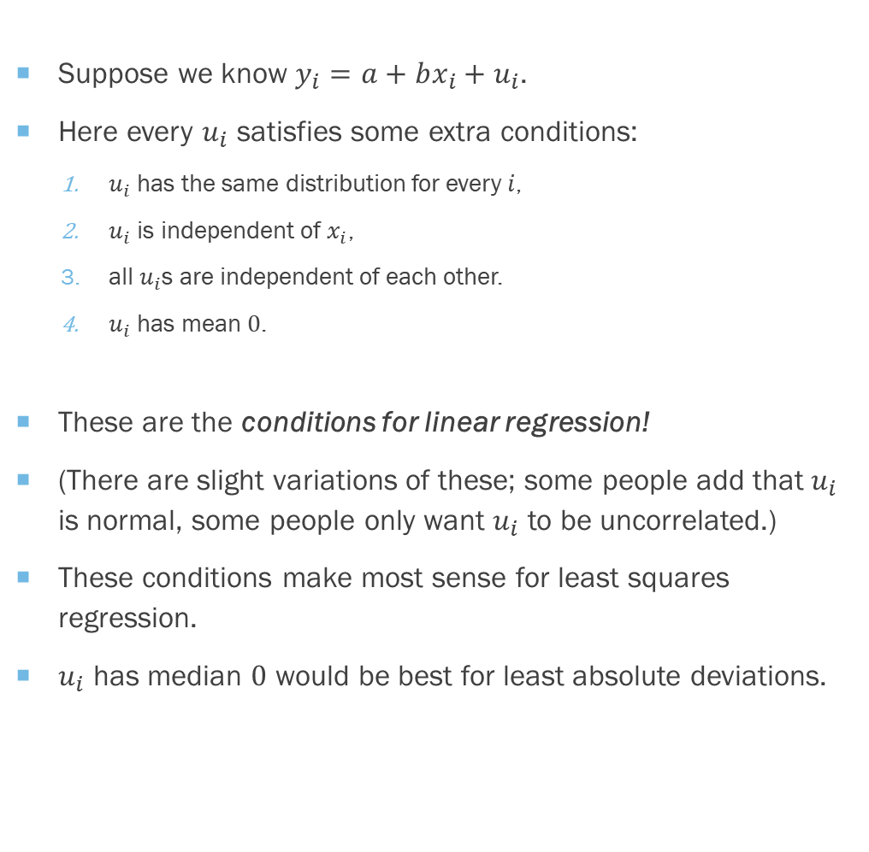
The true linear model
Suppose we know $y_{i}=a+bx_{i}+u_{i}$.
Here every $u_{i}$ satisfies some extra conditions:
$u_{i}$ has the same distribution for every $i$,
$u_{i}$ is independent of $x_{i}$,
all $u_{i}$s are independent of each other.
$u_{i}$ has mean $0$.
These are the conditions for linear regression!
(There are slight variations of these; some people add that $u_{i}$ is normal, some people only want $u_{i}$ to be uncorrelated.)
These conditions make most sense for least squares regression.
$u_{i}$ has median $0$ would be best for least absolute deviations.

Slide 14
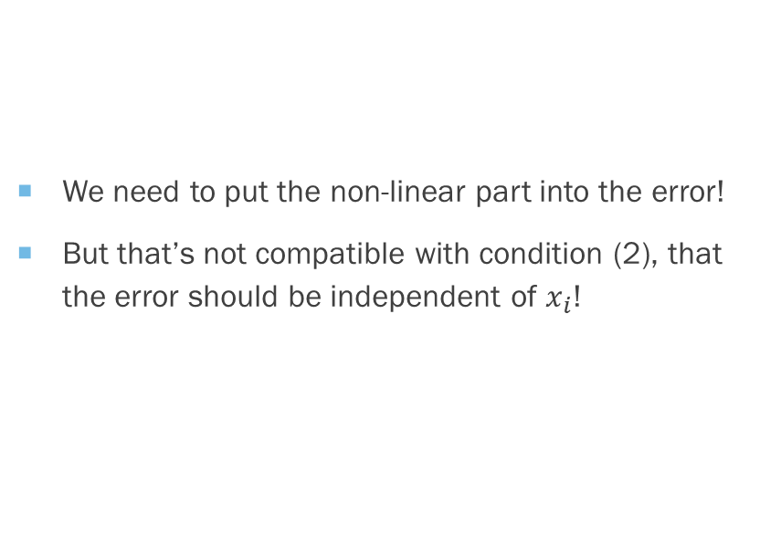
Not at all compatible with the non-linear model
We need to put the non-linear part into the error!
But that’s not compatible with condition (2), that the error should be independent of $x_{i}$!
import numpy as np
import matplotlib.pyplot as plt
rng = np.random.default_rng(seed = 313)
x = np.linspace(0, 1, num = 100)
v = rng.uniform(-1, 1, 100)
u = np.exp(3 * x ** 2) - (2 + 3 * x) + v
y = 2 + 3 * x + u

Slide 15

«Assuming the linear model is true, then… »
This is usually called an "assumption".
Would be better to say "Provided the model is true, then ...“
Or just say “I believe the model is true, and therefore”.

Slide 16

Moral of the story
There is one true regression line!

Slide 17
Now we can ask questions about a and b!
Alice: I made some data from a linear model. Here it is! I promise that the slope is different from 0, I promise I promise!
Bob: Oh yeah?! We’ll see about that!!

Slide 18
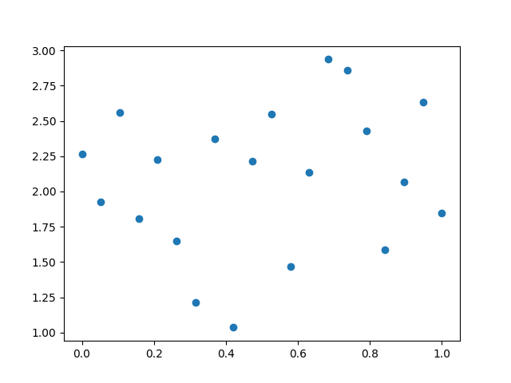
Alice’s is lying! (Unbeknownst to Bob)
import numpy as np
import matplotlib.pyplot as plt
rng = np.random.default_rng(seed = 313)
num = 20
x = np.linspace(0, 1, num = 20)
u = rng.uniform(-1, 1, 20)
y = 2 + 0 * x + u
plt.scatter(x, y)
plt.show()

Slide 19
Bob fits a regression line!
import numpy as np
import matplotlib.pyplot as plt
import statsmodels.formula.api as smf
import pandas as pd
res_ls = smf.ols("y ~ x", data = pd.DataFrame([y, x]).T).fit()
res_ls.params
plt.scatter(x, y)
plt.plot(x, res_ls.params[0] + x * res_ls.params[1], color = "black")
plt.show()
res_ls.params
>>> res_ls.params
Intercept 1.949194
x 0.278595
dtype: float64

Slide 20
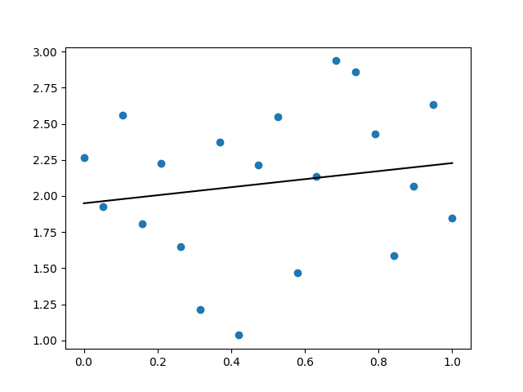
Hmmm… Is the slope 0.2785? or maybe it’s just 0!

Slide 21

But bob knows what to do! he’s a statistician!

Slide 22
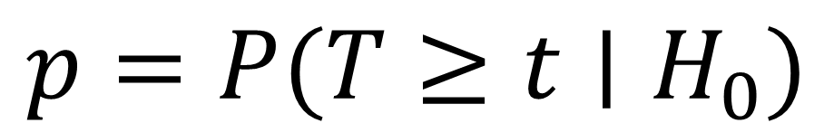
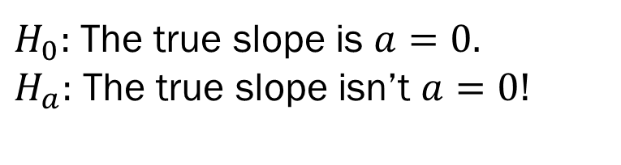
P-values
“[The] p-value is the probability of obtaining test results at least as extreme as the results actually observed, under the assumption that the null hypothesis is correct.” Wikipedia
Don’t simplify this definition!
Don’t formulate it in your own words!
If asked for a definition, give this one!
Don’t get yourself in trouble over the definition of a p-value!
$H_{0}:$ The true slope is $a=0.$
$H_{a}:$ The true slope isn’t $a=0$!
$$p=P(T≥t∣H_{0})$$

Slide 23
«If my null-hypothesis, that Alice is lying, is true, are these results probable?»

Slide 24
# p-value
res = smf.ols("y ~ x", data = pd.DataFrame([y, x]).T).fit()
res.summary()
>>> res.summary()
<class 'statsmodels.iolib.summary.Summary'>
"""
OLS Regression Results
==============================================================================
Dep. Variable: y R-squared: 0.028
Model: OLS Adj. R-squared: -0.026
Method: Least Squares F-statistic: 0.5106
Date: Tue, 07 Sep 2021 Prob (F-statistic): 0.484
Time: 10:39:02 Log-Likelihood: -14.596
No. Observations: 20 AIC: 33.19
Df Residuals: 18 BIC: 35.18
Df Model: 1
Covariance Type: nonrobust
==============================================================================
coef std err t P>|t| [0.025 0.975]
------------------------------------------------------------------------------
Intercept 1.9492 0.228 8.548 0.000 1.470 2.428
x 0.2786 0.390 0.715 0.484 -0.541 1.098
==============================================================================
Omnibus: 1.104 Durbin-Watson: 2.135
Prob(Omnibus): 0.576 Jarque-Bera (JB): 0.992
Skew: -0.373 Prob(JB): 0.609
Kurtosis: 2.205 Cond. No. 4.18
==============================================================================
Notes:
[1] Standard Errors assume that the covariance matrix of the errors is correctly specified.
"""

Slide 25
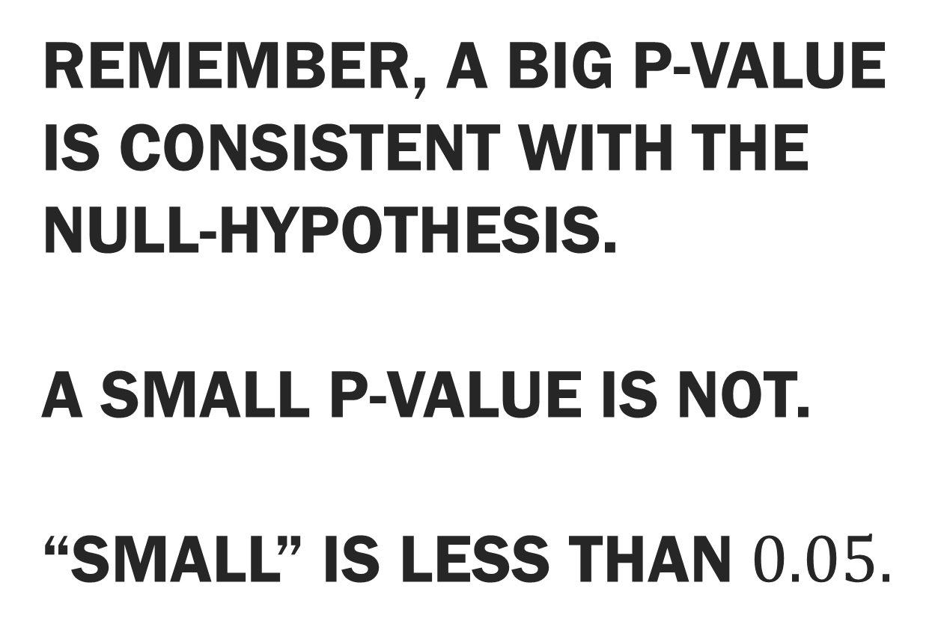
Remember, a Big p-value is consistent with the null-hypothesis. a small p-value is not. “Small” is less than $0.05.$

Slide 26
«I knew it, Alice was lying, the p-value is 0.484!»

Slide 27
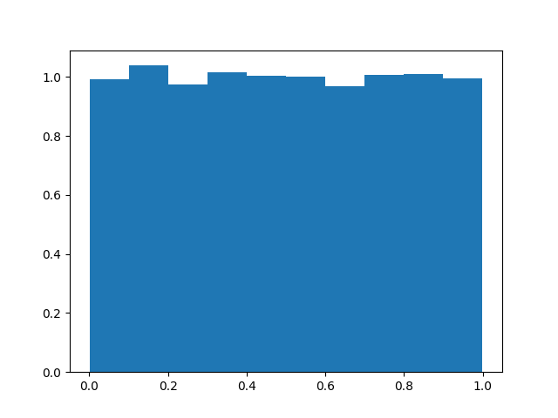
The distribution of the p-values is uniform under the null-hypothesis!
# Simulation.
pvalues = np.zeros(n_reps)
num = 20
for i in range(n_reps):
# Simulate stuff.
x = np.linspace(0, 1, num)
u = rng.normal(0, np.sqrt(res_ls.scale), num)
y = res_ls.params[0] + 0 * x + u
# Fit
res_sim = smf.ols("y ~ x", data = pd.DataFrame([y, x]).T).fit()
pvalues[i] = res_sim.pvalues[1]
plt.hist(pvalues, density = True)
plt.show()

Slide 28
The Point: All p-values are equally likely when the null-hypothesis is true!

Slide 29
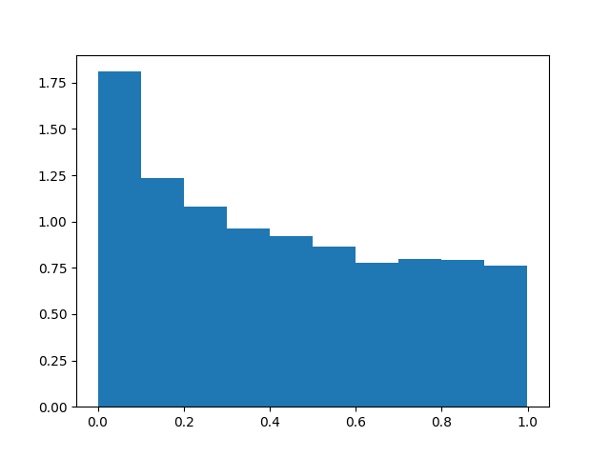
But skewed to the right if the null-hypothesis is false
# Simulation 2.
n_reps = 10000
pvalues = np.zeros(n_reps)
num = 20
for i in range(n_reps):
# Simulate stuff.
x = np.linspace(0, 1, num)
u = rng.normal(0, np.sqrt(res_ls.scale), num)
y = res_ls.params[0] + res_ls.params[1] * x + u
# Fit
res_sim = smf.ols("y ~ x", data = pd.DataFrame([y, x]).T).fit()
pvalues[i] = res_sim.pvalues[1]
plt.hist(pvalues, density = True)
plt.show()

Slide 30
Small p-values are more likely when the null-hypothesis is false!

Slide 31
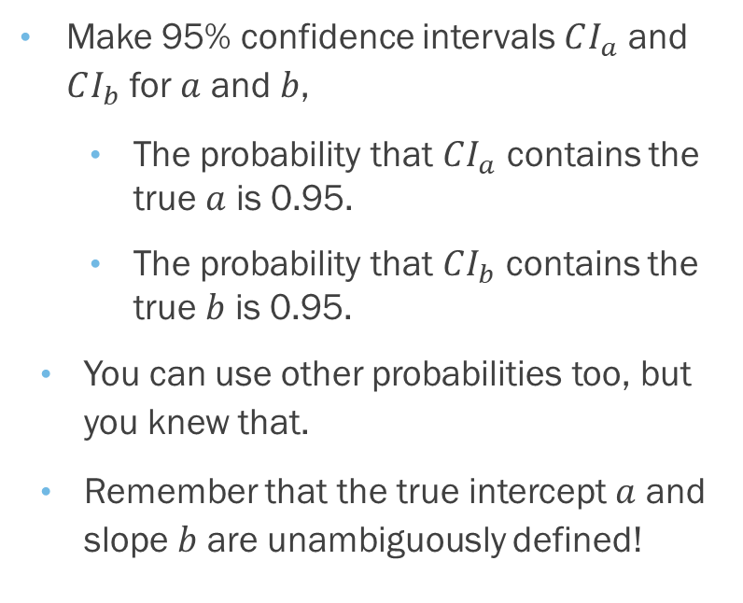
Bob can calculate confidence intervals too!
Make 95% confidence intervals $CI_{a}$ and $CI_{b}$ for $a$ and $b$,
The probability that $CI_{a}$ contains the true $a$ is 0.95.
The probability that $CI_{b}$ contains the true $b$ is 0.95.
You can use other probabilities too, but you knew that.
Remember that the true intercept $a$ and slope $b$ are unambiguously defined!

Slide 32

# p-value
res = smf.ols("y ~ x", data = pd.DataFrame([y, x]).T).fit()
res.summary()
>>> res.summary()
<class 'statsmodels.iolib.summary.Summary'>
"""
OLS Regression Results
==============================================================================
Dep. Variable: y R-squared: 0.028
Model: OLS Adj. R-squared: -0.026
Method: Least Squares F-statistic: 0.5106
Date: Tue, 07 Sep 2021 Prob (F-statistic): 0.484
Time: 10:39:02 Log-Likelihood: -14.596
No. Observations: 20 AIC: 33.19
Df Residuals: 18 BIC: 35.18
Df Model: 1
Covariance Type: nonrobust
==============================================================================
coef std err t P>|t| [0.025 0.975]
------------------------------------------------------------------------------
Intercept 1.9492 0.228 8.548 0.000 1.470 2.428
x 0.2786 0.390 0.715 0.484 -0.541 1.098
==============================================================================
Omnibus: 1.104 Durbin-Watson: 2.135
Prob(Omnibus): 0.576 Jarque-Bera (JB): 0.992
Skew: -0.373 Prob(JB): 0.609
Kurtosis: 2.205 Cond. No. 4.18
==============================================================================
Notes:
[1] Standard Errors assume that the covariance matrix of the errors is correctly specified.
"""

Slide 33
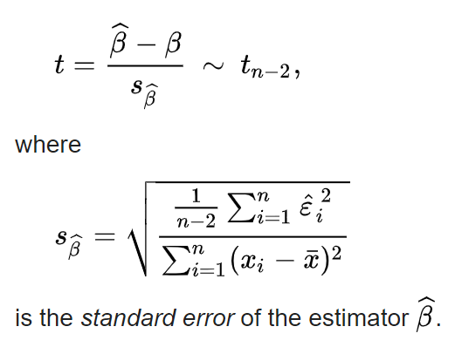
These p-values are based on t-tests.
They are exact when the linear model is true and the residuals are normal.
Are good even when this isn’t the case.

Slide 34

The $R^{2}$ «How well can you predict $y$ from $x$?»

Slide 35


How do we quantify this?
Recall that $a,b$ in $y=a+bx$ are estimated using a distance function.
Minimize $∑d(y_{i},a+bx_{i})$
How about $\min_{m}{∑d(y_{i},m)}$? That’s the best we could do if we know only $y_{i}$!
We will use that as our baseline.

Slide 36
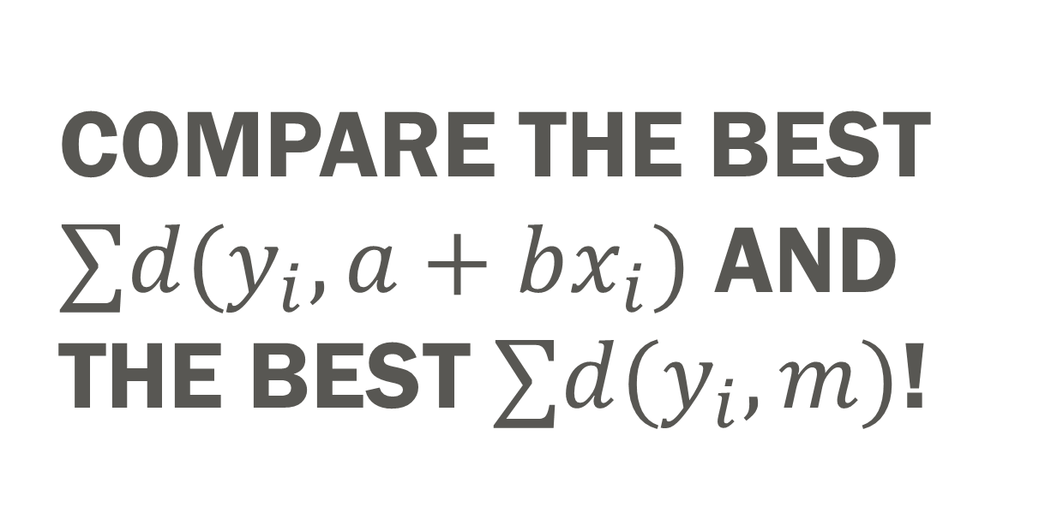
Compare the best $∑d(y_{i},a+bx_{i})$ and the best $∑d(y_{i},m)$!

Slide 37
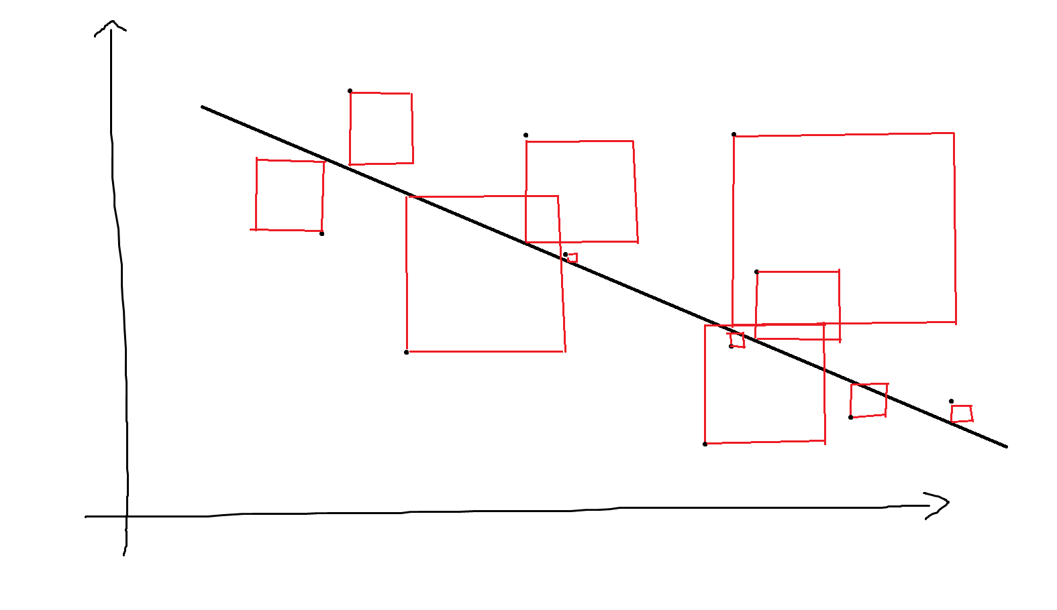
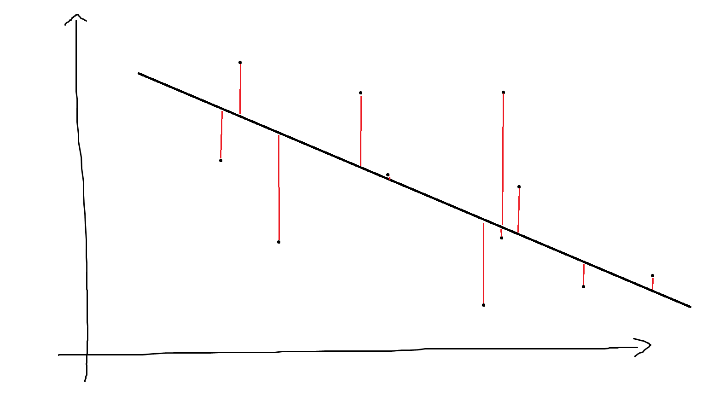
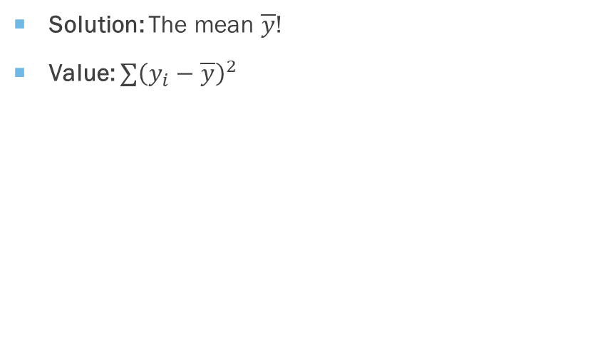

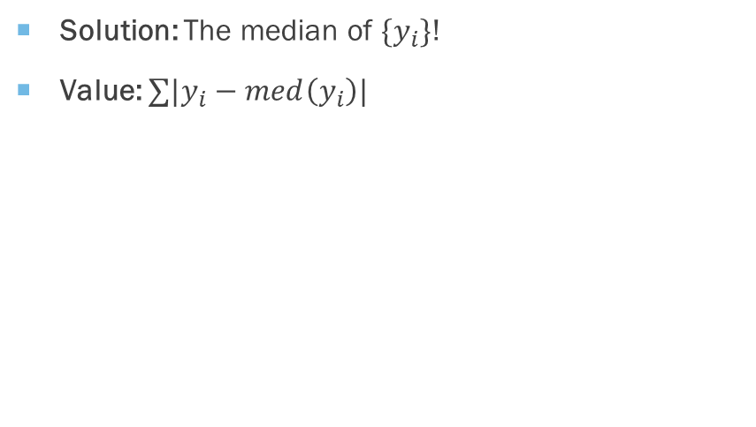
What $m$ minimizes $∑d(y_{i},m)$?
Least squares
Least absolute deviations
Solution: The mean $\overline{y}$!
Value: $∑{\left(y_{i}−\overline{y}\right)}^{2}$
Solution: The median of $\{y_{i}\}$!
Value: $∑|y_{i}−med\left(y_{i}\right)|$

Slide 38
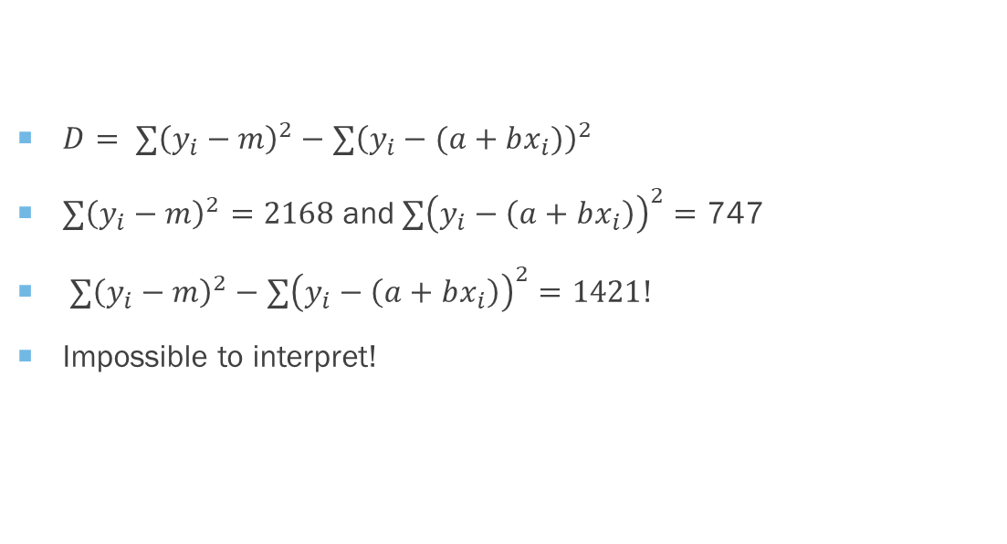
A Scale problem
$D= ∑{\left(y_{i}−m\right)}^{2}−∑{\left(y_{i}−(a+bx_{i})\right)}^{2}$
$∑{\left(y_{i}−m\right)}^{2}=2168$ and$∑{\left(y_{i}−\left(a+bx_{i}\right)\right)}^{2}=\text{747}$
$∑{\left(y_{i}−m\right)}^{2}−∑{\left(y_{i}−\left(a+bx_{i}\right)\right)}^{2}=1421$!
Impossible to interpret!
res_ls = smf.ols("y ~ x", data = pd.DataFrame([y, x]).T).fit()
lower = np.sum((y - np.mean(y)) ** 2)
# 2168.736140549201
upper = np.sum((y - (res_ls.params[0] + x * res_ls.params[1])) ** 2)
# 747.2527517297256
lower - upper
# 1421.4833888194755

Slide 39
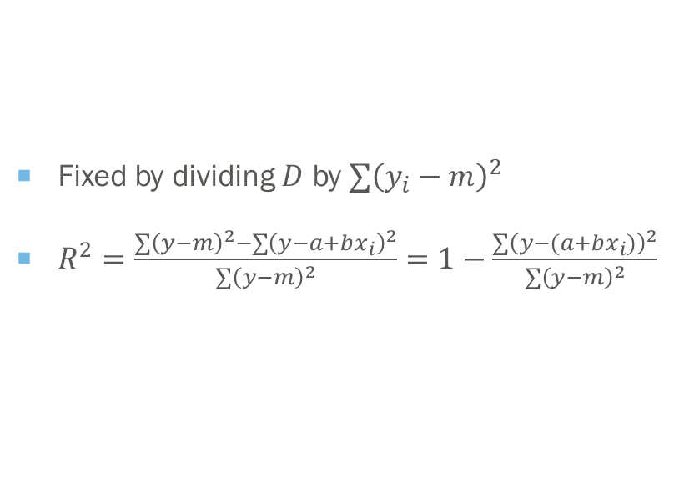
The fix
rng = np.random.default_rng(seed = 313)
x = np.linspace(0, 1, num = 100)
y = np.exp(3 * x ** 2) + rng.uniform(-1, 1, 100)
res_ls = smf.ols("y ~ x", data = pd.DataFrame([y, x]).T).fit()
lower = np.sum((y - np.mean(y)) ** 2)
upper = np.sum((y - (res_ls.params[0] + x * res_ls.params[1])) ** 2)
lower - upper # 1421.4833888194755
1 - upper / lower # 0.6554432151711667
Fixed by dividing $D$ by $∑{\left(y_{i}−m\right)}^{2}$
$R^{2}=\frac{∑{\left(y−m\right)}^{2}−∑{\left(y−a+bx_{i}\right)}^{2}}{∑{\left(y−m\right)}^{2}}=1−\frac{∑{\left(y−(a+bx_{i})\right)}^{2}}{∑{\left(y−m\right)}^{2}}$

Slide 40

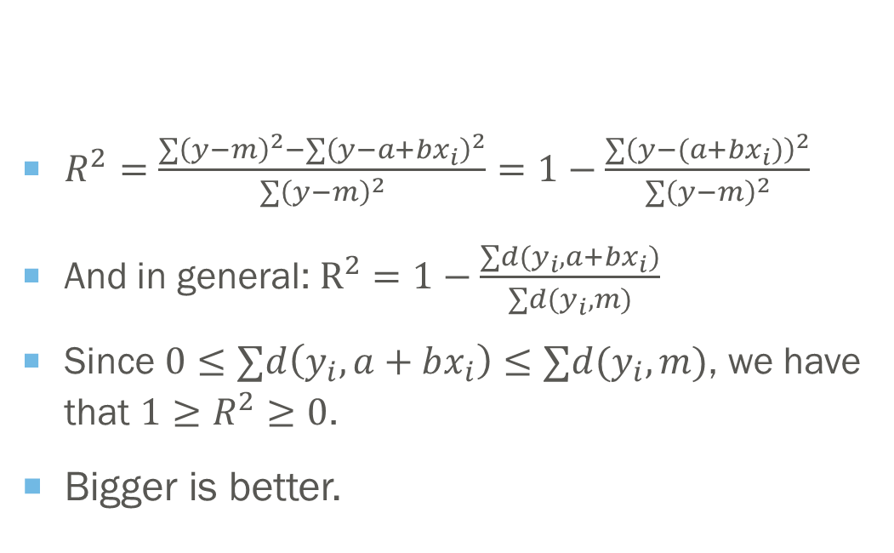

How much better can i predict y using x than without it?
$R^{2}=\frac{∑{\left(y−m\right)}^{2}−∑{\left(y−a+bx_{i}\right)}^{2}}{∑{\left(y−m\right)}^{2}}=1−\frac{∑{\left(y−(a+bx_{i})\right)}^{2}}{∑{\left(y−m\right)}^{2}}$
And in general: $R^{2}=1−\frac{∑d(y_{i},a+bx_{i})}{∑d(y_{i},m)}$
Since $0≤∑d\left(y_{i},a+bx_{i}\right)≤∑d(y_{i},m)$, we have that $1≥R^{2}≥0$.
Bigger is better.
Important: When people talk about $R^{2}$, they talk about least squares almost always!

Slide 41

$$1−\frac{∑d(y_{i},a+bx_{i})}{∑d(y_{i},m)}$$
Korn, E. L., & Simon, R. (1991). Explained Residual Variation, Explained Risk, and Goodness of Fit. The American Statistician, 45(3), 201–206. https://doi.org/10.1080/00031305.1991.10475802

Slide 42
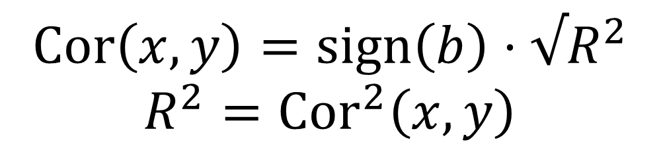
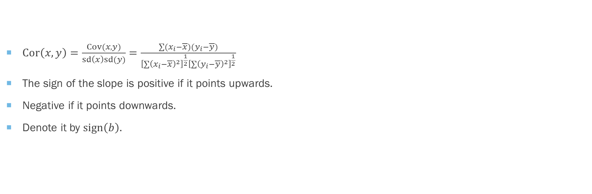
The correlation
Negative slope
$Cor\left(x,y\right)=\frac{Cov(x,y)}{sd\left(x\right)sd(y)}=\frac{∑(x_{i}−\overline{x})(y_{i}−\overline{y})}{{\left[∑{\left(x_{i}−\overline{x}\right)}^{2}\right]}^{\frac{1}{2}}{\left[∑{\left(y_{i}−\overline{y}\right)}^{2}\right]}^{\frac{1}{2}}}$
The sign of the slope is positive if it points upwards.
Negative if it points downwards.
Denote it by $sign\left(b\right)$.
Positive slope
$$Cor\left(x,y\right)=sign\left(b\right)⋅√R^{2}$$
$$R^{2}={Cor}^{2}\left(x,y\right)$$

Slide 43
Has nothing to do with the real shape of the regression model!

Slide 44
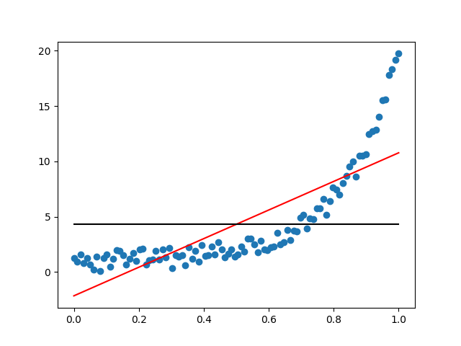
# rsq prototype 2
import numpy as np
import statsmodels.formula.api as smf
import pandas as pd
import matplotlib.pyplot as plt
res_ls = smf.ols("y ~ x", data = pd.DataFrame([y, x]).T).fit()
lower = np.sum((y - np.mean(y)) ** 2)
# 2168.736140549201
upper = np.sum((y - (res_ls.params[0] + x * res_ls.params[1])) ** 2)
# 747.2527517297256
1 - upper / lower # 0.6554432151711667
res_ls.rsquared # 0.6554432151711667
np.corrcoef(x, y)[0, 1]**2 # 0.6554432151711672
np.mean(y) # 4.304984335161987
plt.scatter(x, y)
plt.plot(x, res_ls.params[0] + x * res_ls.params[1], color = "red")
plt.plot(x, np.mean(y) + 0 * x , color = "black")
plt.show()

Slide 45
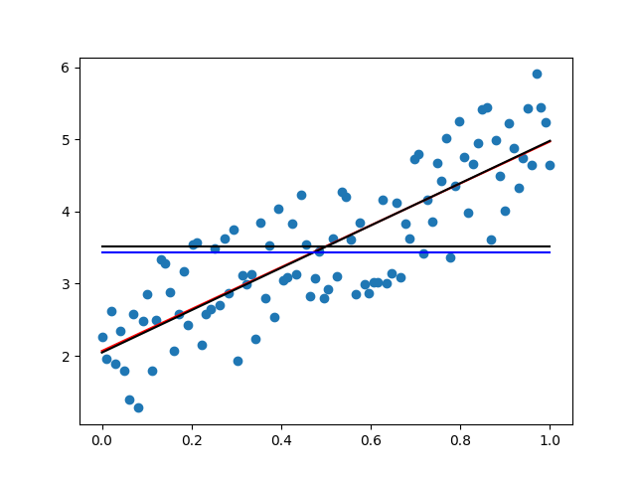
What about Least absolute deviations?
# rsq prototype 1
import numpy as np
import statsmodels.formula.api as smf
import pandas as pd
import matplotlib.pyplot as plt
rng = np.random.default_rng(seed = 313)
x = np.linspace(0, 1, num = 100)
y = 2 + 3 * x + rng.uniform(-1, 1, 100)
res_ls = smf.ols("y ~ x", data = pd.DataFrame([y, x]).T).fit()
res_lad = smf.quantreg("y ~ x", data = pd.DataFrame([y, x]).T).fit(q = 0.5)
lower = np.sum(abs(y - np.median(y)))
upper = np.sum(abs(y - (res_lad.params[0] + x * res_lad.params[1])))
1 - upper / lower # 0.4282332871090164
res_ls.rsquared # 0.6888118053315937
plt.scatter(x, y)
plt.plot(x, res_ls.params[0] + x * res_ls.params[1], color = "red")
plt.plot(x, res_lad.params[0] + x * res_lad.params[1], color = "black")
plt.plot(x, np.mean(y) + 0 * x , color = "black")
plt.plot(x, np.median(y) + 0 * x , color = "blue")
plt.show()

Slide 46

But what’s the best prediction I Can do of Y given X, period?!
You’re not Bob – you don’t believe that the graph below is linear!

Slide 47

«Bob, I’m giving you some data on the form $e^{ax^{b}}+u$. I’m dead serious this time!»

Slide 48

What should Bob do? minimize $∑d(y_{i},e^{ax_{i}^{b}})$ over $a$ and $b$!

Slide 49

We will use curve_fit from scipy.optimize
>>> from scipy.optimize import curve_fit
>>> help(curve_fit)
Help on function curve_fit in module scipy.optimize.minpack:
curve_fit(f, xdata, ydata, p0=None, sigma=None, absolute_sigma=False, check_finite=True, bounds=(-inf, inf), method=None, jac=None, **kwargs)
Use non-linear least squares to fit a function, f, to data.
You must use a computer routine; there's typically no closed form solution!
This is a least squares procedure!

Slide 50
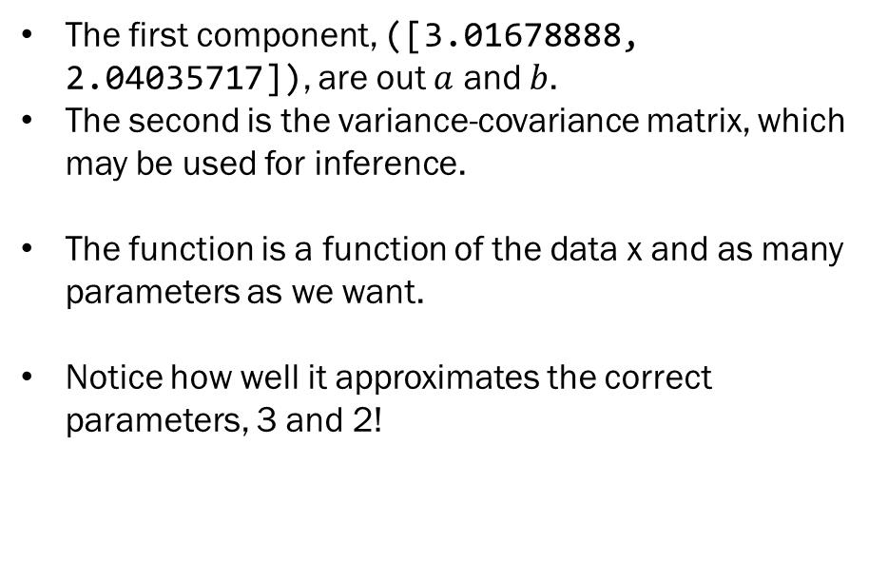
Using the function
from scipy.optimize import curve_fit
rng = np.random.default_rng(seed = 313)
x = sort(np.linspace(0, 1, num = 100))
u = rng.uniform(-1, 1, 100)
y1 = 2 + 3 * x + u # prototype 1
y2 = np.exp(3 * x ** 2) + u # prototype 2
# The function Alice gave Bob!
func = lambda x, a, b: np.exp(a * x ** b)
>>> curve_fit(func, x, y2)
(array([3.01678888, 2.04035717]), array([[0.00019554, 0.00040825],
[0.00040825, 0.00209514]]))
The first component, ([3.01678888, 2.04035717]), are out $a$ and $b$.
The second is the variance-covariance matrix, which may be used for inference.
The function is a function of the data x and as many parameters as we want.
Notice how well it approximates the correct parameters, 3 and 2!

Slide 51
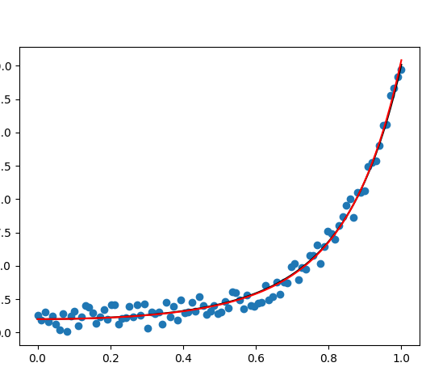
Can you spot the black line?
plt.scatter(x, y2)
plt.plot(x, func(x, 3, 2), color = "black")
plt.plot(x, func(x, param2[0], param2[1]), color = "red")
plt.show()

Slide 52


And we can calculate the non-linear $R_{nls}^{2}$
lower = np.sum((y2 - np.mean(y2)) ** 2) # 2168.736140549201
upper = np.sum((y2 - func(x, param2[0], param2[1])) ** 2) # 32.016818192175435
1 - upper / lower
>>> 1 - upper / lower
0.9852371076436861
>>> np.corrcoef(x, y2)[1, 0] ** 2
0.6554432151711672
Much more impressive than 0.66 from the linear model!
(Such a high $R_{nls}^{2}$ is quite rare though.)

Slide 53
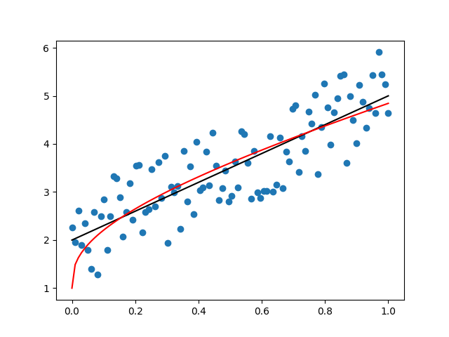
What about the linear model?
param1 = curve_fit(func, x, y1)[0]
plt.scatter(x, y1)
plt.plot(x, 2 + 3 * x, color = "black")
plt.plot(x, func(x, param1[0], param1[1]), color = "red")
plt.show()

Slide 54

we can calculate the non-linear $R^{2}$
lower = np.sum((y2 - np.mean(y2)) ** 2) # 2168.736140549201
upper = np.sum((y2 - func(x, param2[0], param2[1])) ** 2) # 32.016818192175435
1 - upper / lower
>>> 1 - upper / lower
0.9852371076436861
>>> np.corrcoef(x, y2)[1, 0] ** 2
0.6554432151711672
The flexibility of the model allowed it’s $R^{2}$ to be bigger!

Slide 55

Is this always the case?

Slide 56
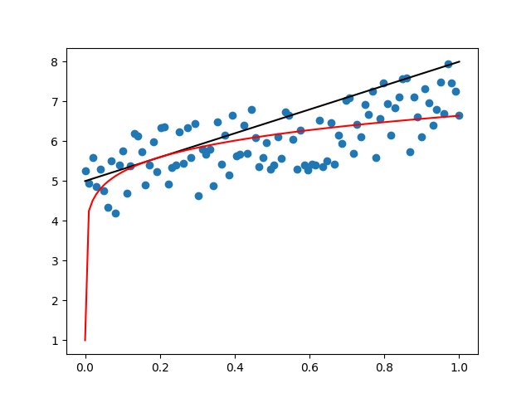
Bad Non-linear least squares
rng = np.random.default_rng(seed = 313)
x = sort(np.linspace(0, 1, num = 100))
u = rng.uniform(-1, 1, 100)
y = 5 + 2 * x + u
param = curve_fit(func, x, y)[0]
plt.scatter(x, y)
plt.plot(x, 5 + 3 * x, color = "black")
plt.plot(x, func(x, param[0], param[1]), color = "red")
plt.show()
lower = np.sum((y - np.mean(y)) ** 2)
upper = np.sum((y - func(x, param[0], param[1])) ** 2)
>>> 1 - upper / lower
0.12462613272055834
>>> np.corrcoef(x, y)[1, 0] ** 2
0.4875571269866591

Slide 57
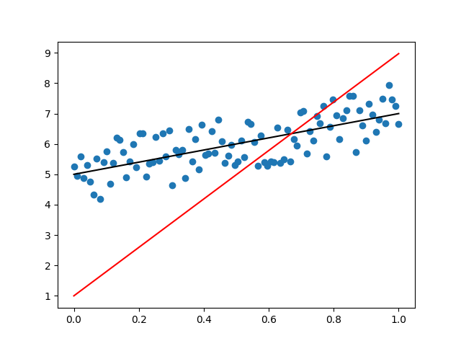
Horrible least squares
rng = np.random.default_rng(seed = 313)
x = sort(np.linspace(0, 1, num = 100))
u = rng.uniform(-1, 1, 100)
y = 5 + 2 * x + u
func = lambda x, a, b: a*x + np.exp(b*x)
param = curve_fit(func, x, y)[0]
plt.scatter(x, y)
plt.plot(x, 5 + 2 * x, color = "black")
plt.plot(x, func(x, param[0], param[1]), color = "red")
plt.show()
lower = np.sum((y - np.mean(y)) ** 2)
upper = np.sum((y - func(x, param[0], param[1])) ** 2)
>>> 1 - upper / lower
-6.153148272325556
>>> np.corrcoef(x, y)[1, 0] ** 2
0.4875571269866591

Slide 58

The non-linear estimator does much worse than the mean. Hence $R_{nls}^{2}=−6$!

Slide 59
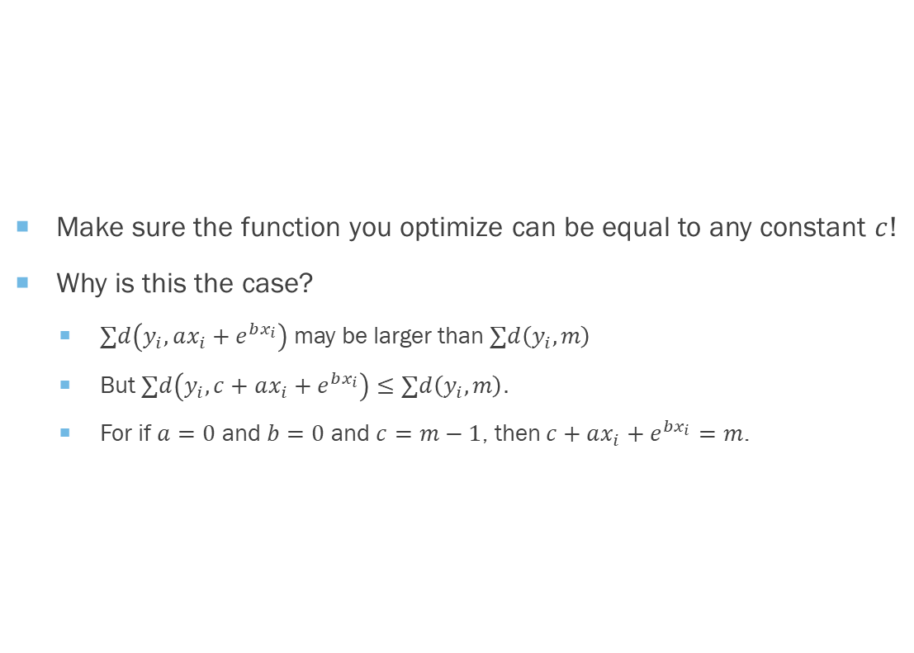

Can you make $1≥R_{nls}^{2}≥0$ always?
Make sure the function you optimize can be equal to any constant $c$!
Why is this the case?
$∑d\left(y_{i},ax_{i}+e^{bx_{i}}\right)$ may be larger than $∑d\left(y_{i},m\right)$
But $∑d\left(y_{i},c+ax_{i}+e^{bx_{i}}\right)≤∑d\left(y_{i},m\right).$
For if $a=0$ and $b=0$ and $c=m−1$, then$c+ax_{i}+e^{bx_{i}}=m$.

Slide 60
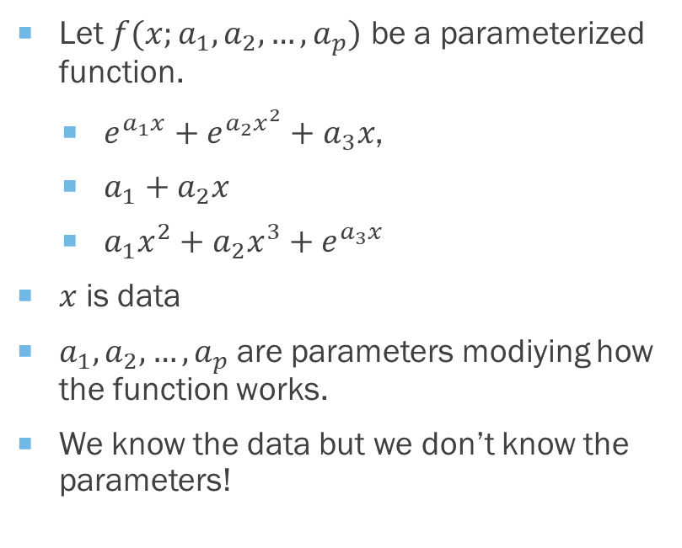
Works on Parameterized functions
Let $f(x;a_{1},a_{2},…,a_{p})$ be a parameterized function.
$e^{a_{1}x}+e^{a_{2}x^{2}}+a_{3}x$,
$a_{1}+a_{2}x$
$a_{1}x^{2}+a_{2}x^{3}+e^{a_{3}x}$
$x$ is data
$a_{1},a_{2},…,a_{p}$are parameters modiying how the function works.
We know the data but we don’t know the parameters!

Slide 61

Pros of non-linear least squares
Can use any function shape!
Sometimes we know the shape of a function.
Especially in chemistry, physics, pharmacology.
Real sciences!
Is easy to understand and use.
Inference is easy enough; we won’t cover it though.

Slide 62
Cons of non-linear least squares
Slower!
Unique solution? Any solution? Hard to say! (Not that important to practically minded people!)
Numerically not well-behaved; may have to transform data. May act unexpectedly!
Not well-known.
You need to guess or know the functional form. See here for examples.

Slide 63
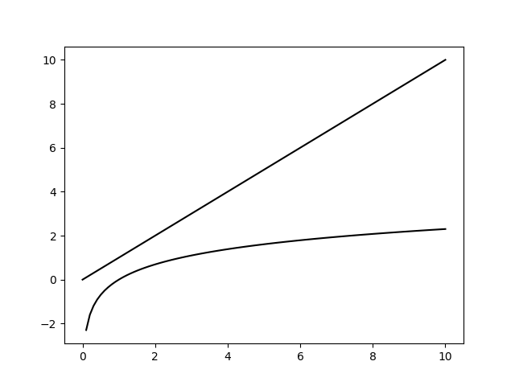
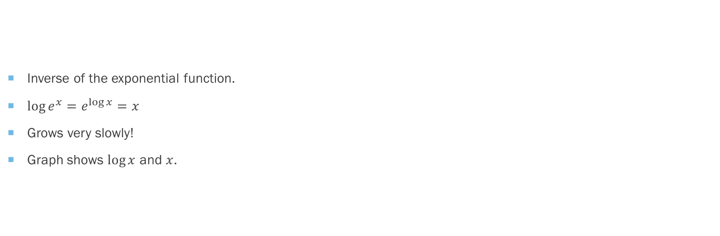
The Logarithm
Inverse of the exponential function.
$\log{e^{x}}=e^{\log{x}}=x$
Grows very slowly!
Graph shows $\log{x}$ and $x$.

Slide 64
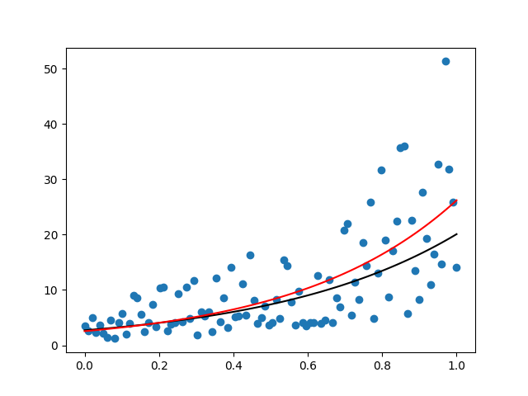

$$y=e^{1+2x+u}$$
rng = np.random.default_rng(seed = 313)
x = np.linspace(0, 1, num = 100)
u = rng.uniform(-1, 1, 100)
y = np.exp(1 + 2 * x + u)
func = lambda x, a, b: np.exp(a + b * x)
param = curve_fit(func, x, y)[0]
plt.scatter(x, y)
plt.plot(x, func(x, 1, 2), color = "black")
plt.plot(x, func(x, *param), color = "red")
plt.show()
Multiplicative errors!

Slide 65
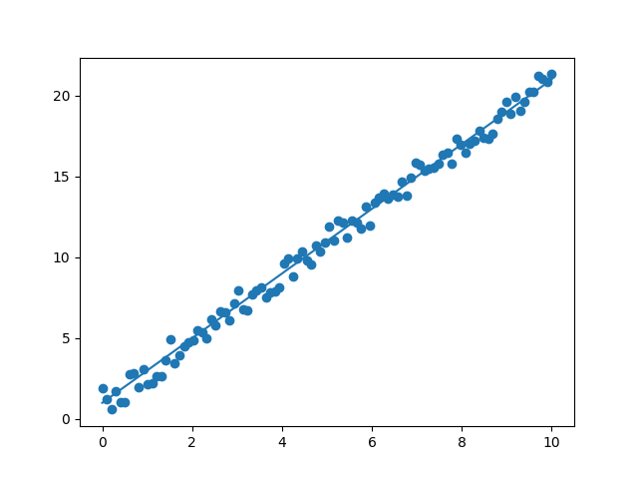

What about this one?
$$\log{y}=1+2x+u$$
import numpy as np
import matplotlib.pyplot as plt
x = np.linspace(0, 10, num = 100)
u = rng.uniform(-1, 1, 100)
y = np.exp(1 + 2 * x + u)
plt.scatter(x, np.log(y))
plt.plot(x, 1 + 2 * x)
plt.show()

Slide 66

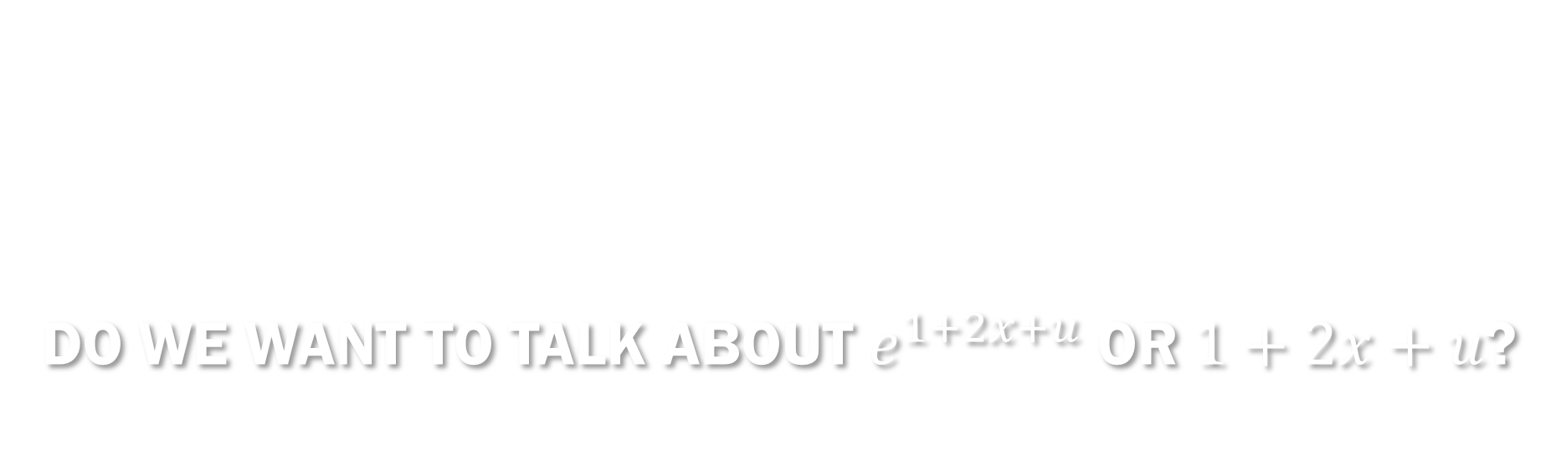
Do we want to talk about $e^{1+2x+u}$or $1+2x+u$?

Slide 67

Difference In $R^{2}$
rng = np.random.default_rng(seed = 313)
x = np.linspace(0, 1, num = 100)
u = rng.uniform(-1, 1, 100)
y = np.exp(1 + 2 * x + u)
func = lambda x, a, b: np.exp(a + b * x)
param = curve_fit(func, x, y)[0]
lower = np.sum((y - np.mean(y)) ** 2)
upper = np.sum((y - func(x, param[0], param[1])) ** 2)
1 - upper / lower
np.corrcoef(x, np.log(y))[1, 0] ** 2
>>> 1 - upper / lower
0.491781632329627
>>> np.corrcoef(x, np.log(y))[1, 0] ** 2
0.487557126986659
Why? More variability before taking logs!

Slide 68
The scale is larger on the non-transformed plot! So The mean explains less.

Slide 69
Difference in parameter estimates
func = lambda x, a, b: np.exp(a + b * x)
param = curve_fit(func, x, y)[0]
>>> param
array([1.37297845, 1.77035421])
res_ls = smf.ols("np.log(y) ~ x", data = pd.DataFrame([y, x]).T).fit()
>>> res_ls.params
Intercept 1.079184
x 1.999232
dtype: float64
The parameter estimates are closer to 1 and 2 in the log-transformed model.
This is true in general.

Slide 70
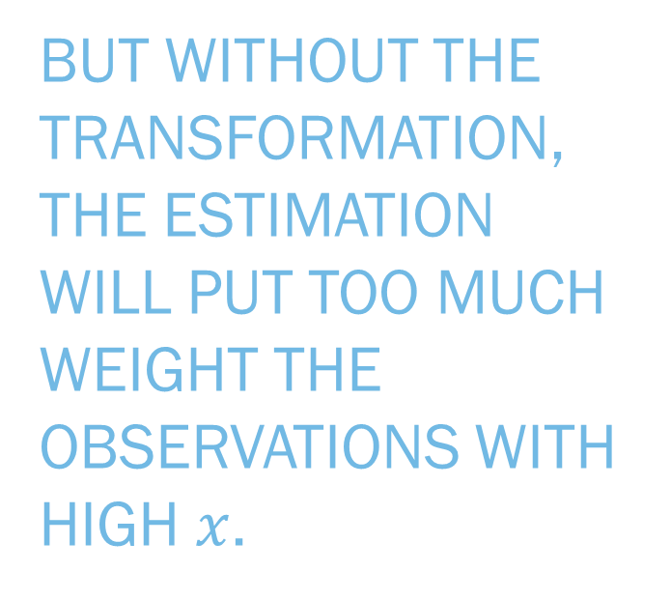
Why does this happen? Complicated reasons!
But without the transformation, the estimation will put too much weight the observations with high $x$.
I may tell you why the logarithmic transform works better later on. The keyword is «efficiency».

Slide 71
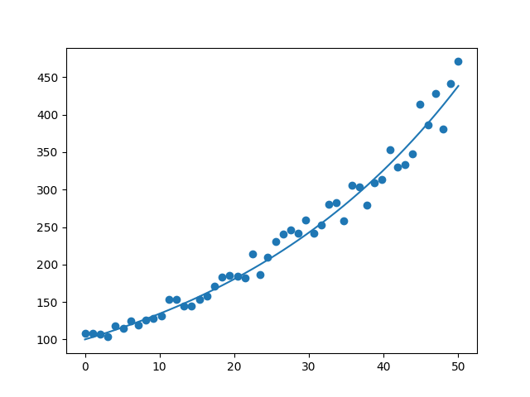
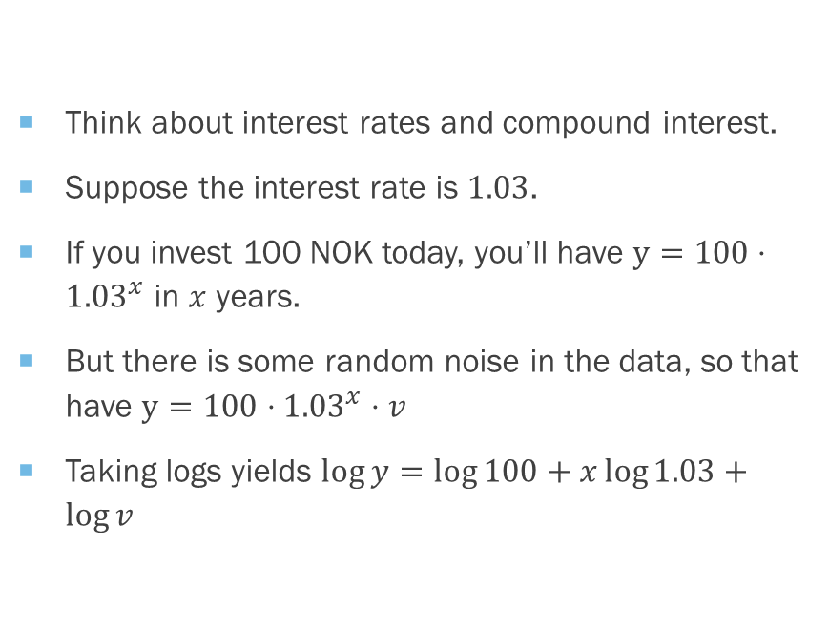
When does it happen? More often than you’d think!
Think about interest rates and compound interest.
Suppose the interest rate is $1.03$.
If you invest 100 NOK today, you’ll have $y=100⋅{1.03}^{x}$ in $x$ years.
But there is some random noise in the data, so that have $y=100⋅{1.03}^{x}⋅v$
Taking logs yields $\log{y}=\log{100}+x\log{1.03}+\log{v}$

Slide 72

You would want to log-transform if you want to estimate the interest rate.
Why? The interest rate is a parameter. And you will estimate it better with the log-transform.

Slide 73

The log-transform may be more interesting than the original data!

Slide 74
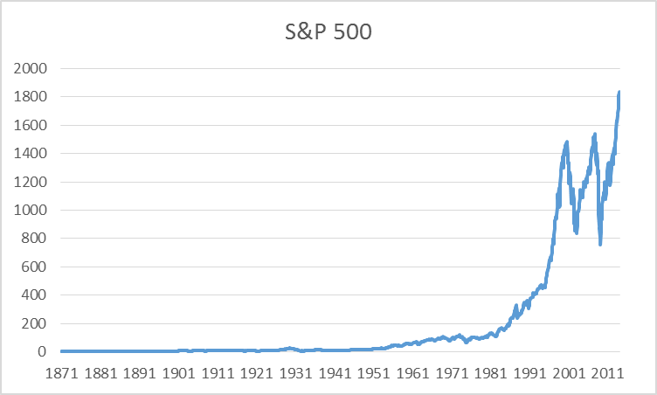
S&P500
Source: https://econbrowser.com/archives/2014/02/use-of-logarithms-in-economics (James Hamilton)
“Plotted on this scale, one can see nothing in the first century,
whereas the most recent decade appears insanely volatile.”

Slide 75
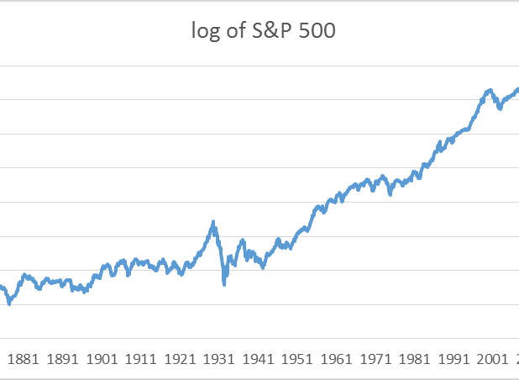
Logarithm of S&P500
“On the other hand, if you plot these same data on a log scale, a vertical move of 0.01 corresponds to a 1% change at any point in the figure. Plotted this way, it’s clear that, in percentage terms, the recent volatility of stock prices is actually modest relative to what happened in the Great Depression in the 1930’s.”

Slide 76
Linear models are much more familiar!
Linear model will have more precise estimates too, Provided the exponential model is true!
And may be more interesting.

Slide 77
If you’re not sure, transform.

Slide 78

Bye Bye

